Slide 1
End to End Machine Learning I
Dr. Sugata Ghosal
CSIS Off-Campus Faculty
BITS Pilani

Slide 2
Challenges of Machine Learning
Dr. Sugata Ghosal
CSIS Off-Campus Faculty
BITS Pilani

Slide 3
In this segment
Training Data
Insufficient
Non representative
Poor Quality
Irrelevant attributes
Model Selection
Overfitting
Underfitting
Testing and Validation
Hyperparameters

Slide 4
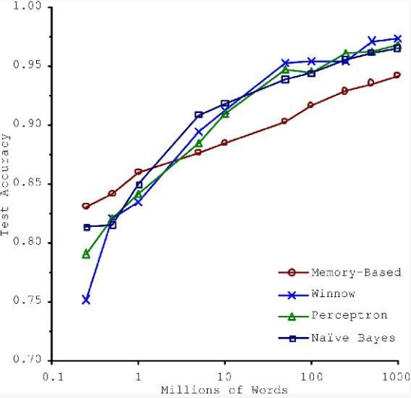
Insufficient Training Data
Consider trade-off Between Algorithm development & training data capture

Slide 5
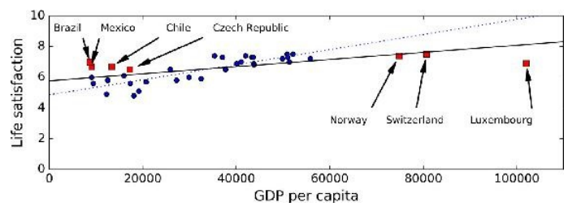
Non-representative Training Data
Training Data be representative of the new cases we want to generalize
Small sample size leads to sampling noise
Missing data over emphasizes the role of wealth on happiness
If sampling process is flawed, even large sample size can lead to sampling bias
missing data
available data

Slide 6
Data Quality
Cleaning often needed for improving data quality
Some instances have missing features
e.g., 5% of customers did not specify their age
Ignore the instances all together or the feature,
fill in the missing values
Train multiple ML models
Some instances can be erroneous, noisy or outliers
Human or machine generated
Identify, discard or fix manually, as appropriate

Slide 7
Irrelevant Features
Feature engineering needed for coming up with a good set of features
Feature selection
more useful features to train on among existing features.
Feature extraction
combine existing features to produce a more useful one.
Create new features by gathering new data

Slide 8
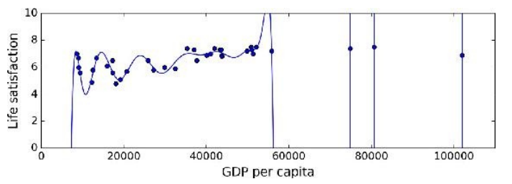
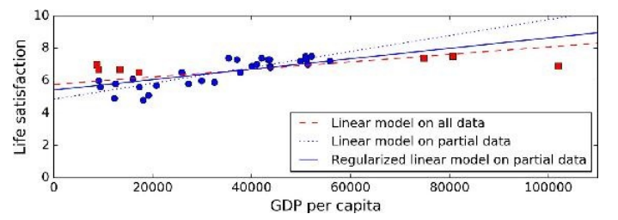
Model Selection
Overfitting or Underfitting
Overfitting leads to high performance in training set but performs poorly on new data
e.g., a high-degree polynomial life satisfaction model that strongly overfits the training data
Small training set or sampling noise can lead to model following the noise than the underlying pattern in the dataset
Solution: Regularization
Underfitting when the model is too simple to learn the underlying structure in the data
Select a more powerful model, with more parameters
Feed better features to the learning algorithm
Reduce regularization
Large slope
Smaller slope
High-order
polynomial

Slide 9
Testing and Validation
Performance of ML algorithms is statistical / predictive
Good ML algorithms need to work well on test data
But test data is often not accessible to the provider of the algorithm
Common assumption is training data is representative of test data
Randomly chosen subset of the training data is held out as validation set
aka dev set
Once ML model is trained, its performance is evaluated on validation data
Expectation is ML model working well on validation set will work well on unknown test data
Typically 20-30% of the data is randomly held out as validation data

Slide 10
Cross Validation
K-fold validation is often performed
To reduce the bias of validation set selection process
Often K is chosen as 10
aka 10 fold cross validation
10 fold cross validation involves
randomly selecting the validation set 10 times
model generation with 10 resulting training set
Evaluate the performance of each on that validation set
averaging the performance over the validation sets

Slide 11
Choice of Hyperparameters
Modern ML models often use a lot of model parameters
Known as hyperparameters
Model performance depends on choice of parameters
Each parameter can assume a number of values
Real numbers or categories
Exponential number of hyperparameter combinations possible
Best model correspond to best cross validation performance over the set of hyperparameter combinations
Expensive to perform
Some empirical frameworks available for hyperparameter optimization

Slide 12
















Testing and Validation
x can be multi-dimensional
– Each dimension corresponds to an attribute
Clump Thickness
Uniformity of Cell Size
Uniformity of Cell Shape
…
Age
Tumor Size

Slide 13
Testing and Validation
x can be multi-dimensional
– Each dimension corresponds to an attribute
Clump Thickness
Uniformity of Cell Size
Uniformity of Cell Shape
…
Age
Tumor Size

Slide 14
Thank You!
In our next segment: End to End ML

Slide 15
In this Segment
Frame the Machine Learning Problem
Business Context Understanding
Model Selection
Performance Metric Selection
Check the assumptions

Slide 16
Key Elements of a Machine Learning Project
Framing a machine learning problem
Data types and representation
Data Pre processing
Data Visualization and Analysis
Feature Engineering
Model Building and testing

Slide 17
An Example Problem Statement
Start with the Big Picture
Build a model of housing prices using the census data.
Data attributes <population, median income, median housing price, ….> and so on for each district
Districts are the smallest geographical unit (population ~600 – 3000)
The model to predict the median housing price in any district, given all the other metrics.
Goodness of the model is determined by how close the model output is w.r.t. actual price for unseen district data

Slide 18
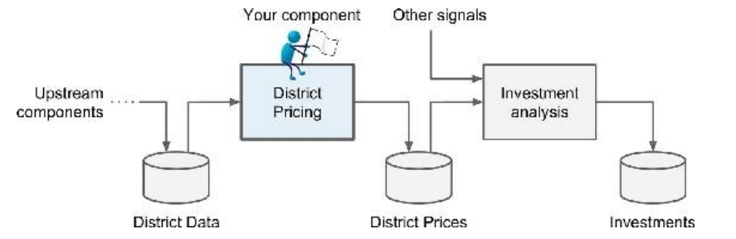
Framing the Problem
Understand the Business Objective and Context
What is the expected usage and benefit?
impacts the choice of algorithms, goodness measure, and effort in lifecycle management of the model
What is the baseline method and its performance?

Slide 19
Choice of Model
Choose between Different techniques
Supervised or unsupervised? Prediction or classification? Online Vs. Batch? Instance-based or Model-based?
Analyze the dataset
Each instance comes with the expected output, i.e., the district’s median housing price.
supervised
Goal is to predict a real valued price based on multiple variables line population, income etc.
regression
Output is based on input data at rest, not rapidly changing data rapidly.
Dataset small enough to fit in memory
batch
So, it’s a supervised multivariate batch regression problem
cv
cv

Slide 20
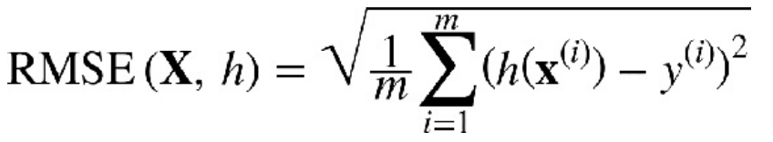
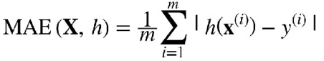
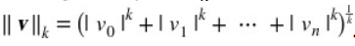
Choice of Performance Metrics
A typical Choice for Regression: Root Mean Square Error (RMSE)
h is the model, X is the training dataset, m is number of instances, x^{(i)} is i-th instance, y^{(i)} is the actual price for the i-th instance.
Mean Absolute Error (MAE)
MAE is preferred for a large number of outliers. aka L₁ norm or Manhattan distance/norm.
General Form

Slide 21
Stepping Back
Check the Assumptions
Verify that the downstream module actually uses real-valued prices rather than post processing them into say, categories, e.g “cheap,” “medium,” or “expensive”)
If not, the problem should have been framed as a classification task, not a regression task.
Such potential hazards need to be checked early in the design rather than finding out from deployed systems

Slide 22
Thank You!
In our next segment: Data

Slide 23
In this segment
Data Types and Representations
What is Data?
Types and properties of attributes of data
Categorization of attributes
Characteristics of Data
Types of Data

Slide 24
What is Data?
Attributes
Collection of data objects and attributes
An attribute is a property or characteristic of an object
Examples: eye color of a person, temperature, etc.
aka variable, field, characteristic, dimension, or feature
A collection of attributes describe an object
aka record, point, case, sample, entity, or instance
Attribute values are numbers or symbols assigned to an attribute for a particular object
Distinction between attributes and attribute values
Same attribute can be mapped to different attribute values
Example: height can be measured in feet or meters
Different attributes can be mapped to the same set of values
Example: Attribute values for ID and age are integers
But properties of attribute can be different than the properties of the values used to represent the attribute
Objects

Slide 25
Discrete and Continuous Attributes
Discrete Attribute
Has only a finite or countably infinite set of values
Examples: zip codes, counts, or the set of words in a collection of documents
Often represented as integer variables.
Note: binary attributes are a special case of discrete attributes
Continuous Attribute
Has real numbers as attribute values
Examples: temperature, height, or weight.
Practically, real values can only be measured and represented using a finite number of digits.
Continuous attributes are typically represented as floating-point variables.

Slide 26
Types and properties of Attributes
Types
Nominal
ID numbers, eye color, zip codes
Ordinal
rankings (e.g., taste of potato chips on a scale from 1-10), grades, height {tall, medium, short}
Interval
calendar dates, temperatures in Celsius or Fahrenheit.
Ratio
temperature in Kelvin, length, counts, elapsed time (e.g., time to run a race)
Properties
Distinctness: = ≠
Order: < >
Differences are + - meaningful :
Ratios are * / meaningful :

Slide 27
Difference Between Ratio and Interval
Is it physically meaningful to say that a temperature of 10 ° is twice that of 5° on
the Celsius scale?
the Fahrenheit scale?
the Kelvin scale?
Consider measuring the height above average
If Bill’s height is three inches above average and Bob’s height is six inches above average, then would we say that Bob is twice as tall as Bill?
Is this situation analogous to that of temperature?

Slide 28
Categorization of Attributes

Slide 29
Transformation of Attributes

Slide 30
Asymmetric Attributes
Only presence (a non-zero attribute value) is regarded as important
Words present in documents
Items present in customer transactions
If we met a friend in the grocery store would we ever say the following?
“I see our purchases are very similar since we didn’t buy most of the same things.”

Slide 31
Critiques of the attribute categorization
Incomplete
Asymmetric binary
Cyclical
Multivariate
Partially ordered
Partial membership
Relationships between the data
Real data is approximate and noisy
This can complicate recognition of the proper attribute type
Treating one attribute type as another may be approximately correct

Slide 32
Key Messages for Attribute Types
The types of operations you choose should be “meaningful” for the type of data you have
Distinctness, order, meaningful intervals, and meaningful ratios are only four (among many possible) properties of data
The data type you see – often numbers or strings – may not capture all the properties or may suggest properties that are not present
Analysis may depend on these other properties of the data
Many statistical analyses depend only on the distribution
In the end, what is meaningful can be specific to domain

Slide 33
Important Characteristics of Data
Dimensionality (number of attributes)
High dimensional data brings a number of challenges
Sparsity
Only presence counts
Resolution
Patterns depend on the scale
Size
Type of analysis may depend on size of data

Slide 34
Types of data sets
Record
Data Matrix
Document Data
Transaction Data
Graph
World Wide Web
Molecular Structures
Ordered
Spatial Data
Temporal Data
Sequential Data
Genetic Sequence Data

Slide 35
Record Data
Data that consists of a collection of records, each of which consists of a fixed set of attributes

Slide 36
Data Matrix
If data objects have the same fixed set of numeric attributes, then the data objects can be thought of as points in a multi-dimensional space, where each dimension represents a distinct attribute
Such a data set can be represented by an m by n matrix, where there are m rows, one for each object, and n columns, one for each attribute

Slide 37
Document Data
Each document becomes a ‘term’ vector
Each term is a component (attribute) of the vector
The value of each component is the number of times the corresponding term occurs in the document.

Slide 38
Transaction Data
A special type of data, where
Each transaction involves a set of items.
For example, consider a grocery store. The set of products purchased by a customer during one shopping trip constitute a transaction, while the individual products that were purchased are the items.
Can represent transaction data as record data

Slide 39
Graph Data
Benzene Molecule: C6H6

Slide 40
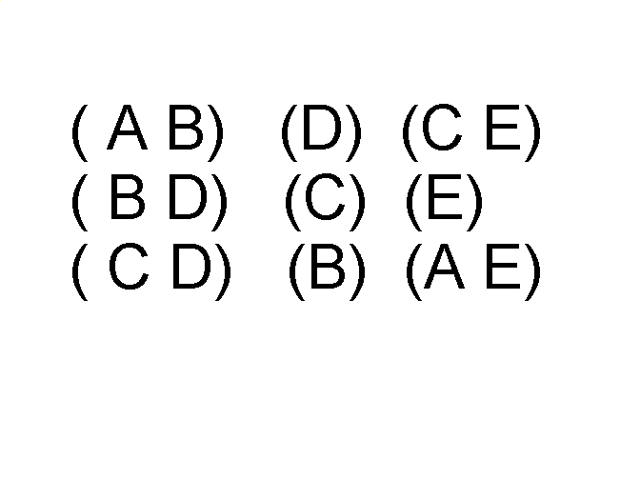
Ordered Data
Sequence of transactions
Items/Events
An element of the sequence

Slide 41
Ordered Data
Genomic sequence data

Slide 42
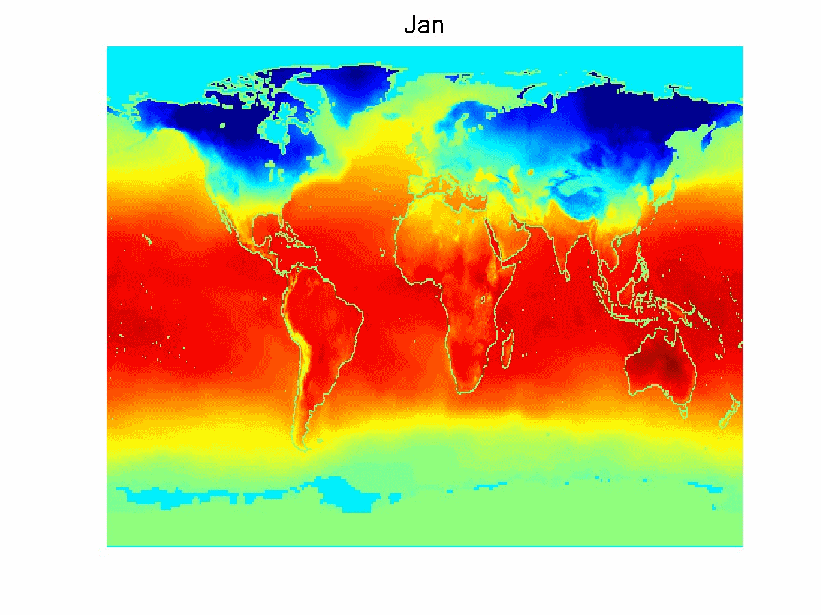
Ordered Data
SpatioTemporal Data
Average Monthly Temperature of land and ocean

Slide 43
Thank You!
In our next segment: Preprocessing

Slide 44
In this segment
Data Preprocessing
Data Quality
Noise, Outlier, Missing attribute, Duplicate record
Data Transformation
Aggregation
Sampling
Discretization and Binarization
Attribute Transformation
Dimensionality Reduction
Feature subset selection
Feature creation

Slide 45
Data Quality
Poor data quality negatively affects many data processing efforts
For example, a classification model for detecting people who are loan risks is built using poor data
Some credit-worthy candidates are denied loans
More loans are given to individuals that default

Slide 46
Data Quality …
What kinds of data quality problems?
How can we detect problems with the data?
What can we do about these problems?
Examples of data quality problems:
Noise and outliers
Wrong data
Fake data
Missing values
Duplicate data

Slide 47
Noise
For objects, noise is an extraneous object
For attributes, noise refers to modification of original values
Examples: distortion of a person’s voice when talking on a poor phone and “snow” on television screen
The figures below show two sine waves of the same magnitude and different frequencies, the waves combined, and the two sine waves with random noise
The magnitude and shape of the original signal is distorted

Slide 48

Outliers
Outliers are data objects with characteristics that are considerably different than most of the other data objects in the data set
Case 1: Outliers are noise that interferes with data analysis
Case 2: Outliers are the goal of our analysis
Credit card fraud
Intrusion detection

Slide 49
Missing Values
Reasons for missing values
Information is not collected (e.g., people decline to give their age and weight)
Attributes may not be applicable to all cases (e.g., annual income is not applicable to children)
Handling missing values
Eliminate data objects or variables
Estimate missing values
Example: time series of temperature
Example: census results
Ignore the missing value during analysis

Slide 50
Duplicate Data
Data set may include data objects that are duplicates, or almost duplicates of one another
Major issue when merging data from heterogeneous sources
Examples:
Same person with multiple email addresses
Data cleaning
Process of dealing with duplicate data issues

Slide 51
Data Preprocessing
Aggregation
Sampling
Discretization and Binarization
Attribute Transformation
Dimensionality Reduction
Feature subset selection
Feature creation

Slide 52
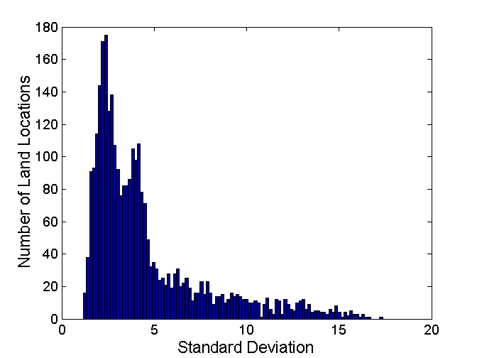
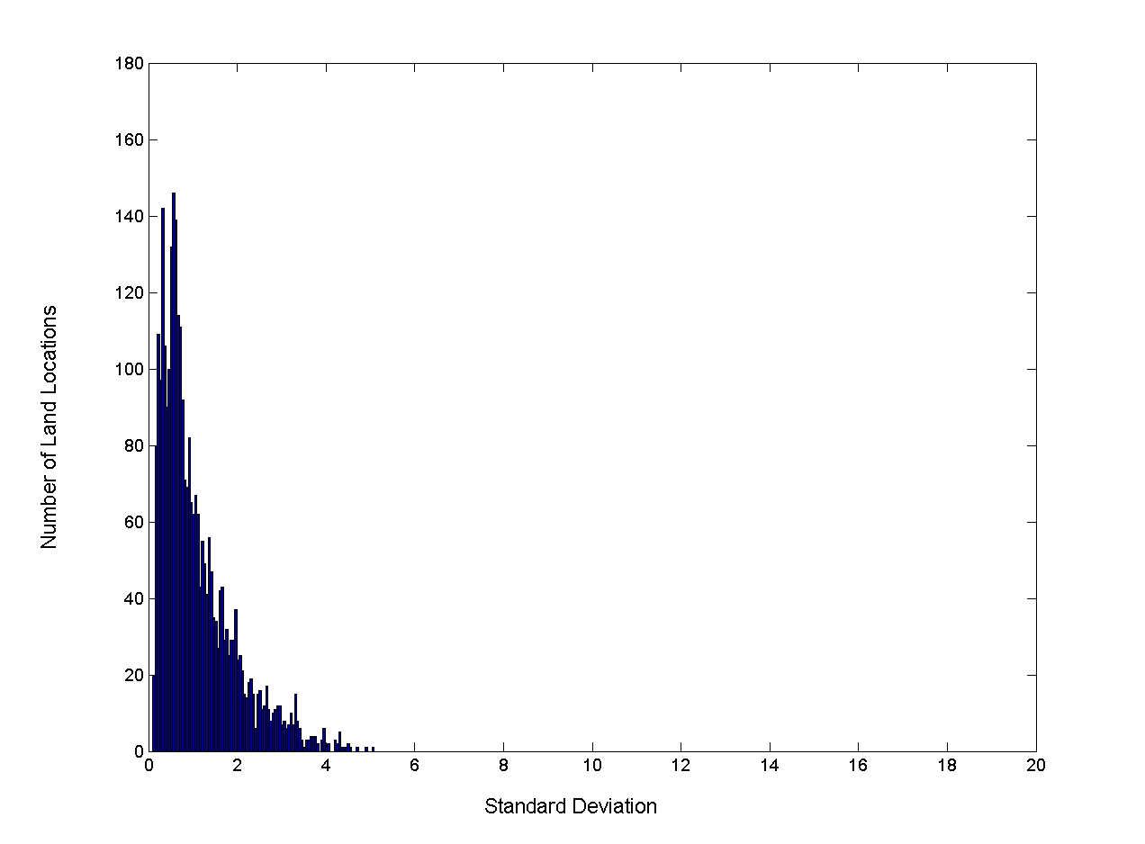
Aggregation
Combining two or more attributes (or objects) into a single attribute (or object)
Purpose
Data reduction
Change of scale
More “stable” data
Standard Deviation of Average Monthly Precipitation
Standard Deviation of Average Yearly Precipitation

Slide 53

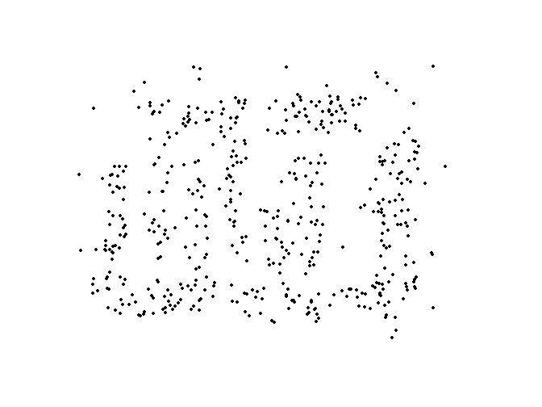
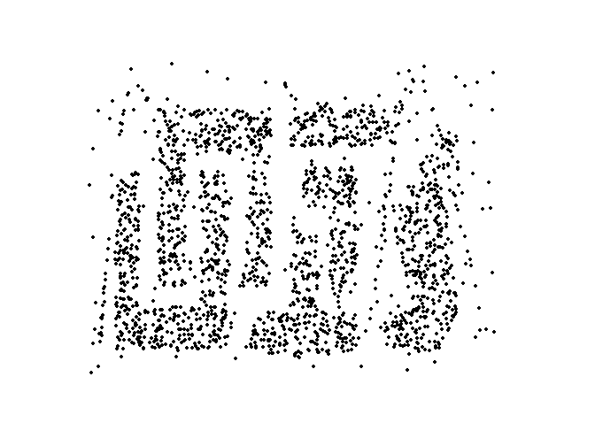
Sampling
Primary technique used for data reduction
It is often used for both the preliminary investigation of the data and the final data analysis.
Statisticians often sample because obtaining the entire set of data of interest is too expensive or time consuming.
Sampling is typically used in machine learning because processing the entire set of data of interest may be too expensive or time consuming.
Key Principle
Using a sample will work almost as well as using the entire data set, if the sample is representative
A sample is representative if it has approximately the same properties as the original dataset
8000 points 2000 Points 500 Points

Slide 54
Sampling …
The key principle for effective sampling is the following:
Using a sample will work almost as well as using the entire data set, if the sample is representative
A sample is representative if it has approximately the same properties (of interest) as the original set of data
Simple Random Sampling
There is an equal probability of selecting any particular item
Sampling without replacement
As each item is selected, it is removed from the population
Sampling with replacement
Objects are not removed from the population as they are selected for the sample.
In sampling with replacement, the same object can be picked up more than once
Stratified sampling
Split the data into several partitions; then draw random samples from each partition

Slide 55
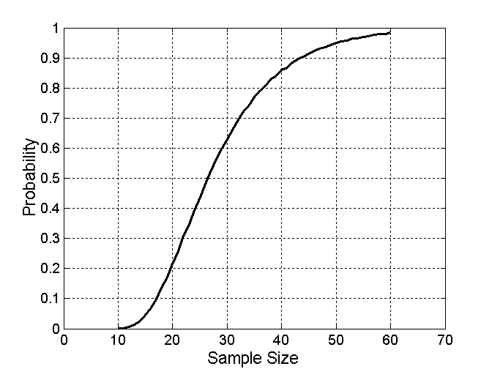
Sample Size
What sample size is necessary to get at least one object from each of 10 equal-sized groups.

Slide 56
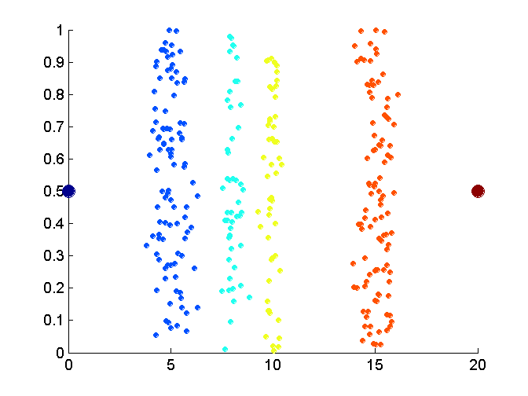
Discretization
Process of converting a continuous attribute into an ordinal attribute
A potentially infinite number of values are mapped into a small number of categories
Discretization is used in both unsupervised and supervised settings
Data consists of four groups of points and two outliers. Data is one-dimensional, but a random y component is added to reduce overlap.

Slide 57
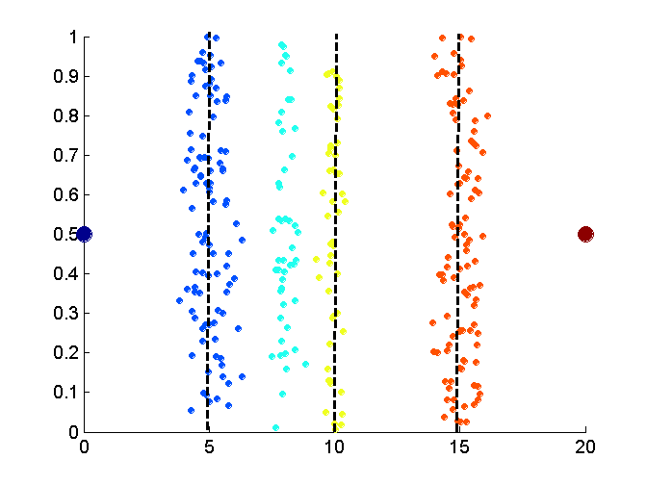
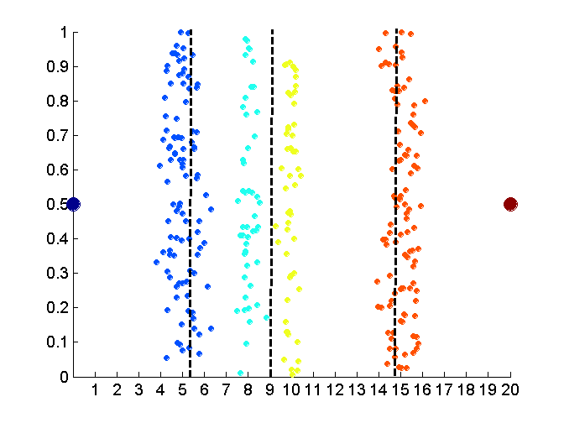
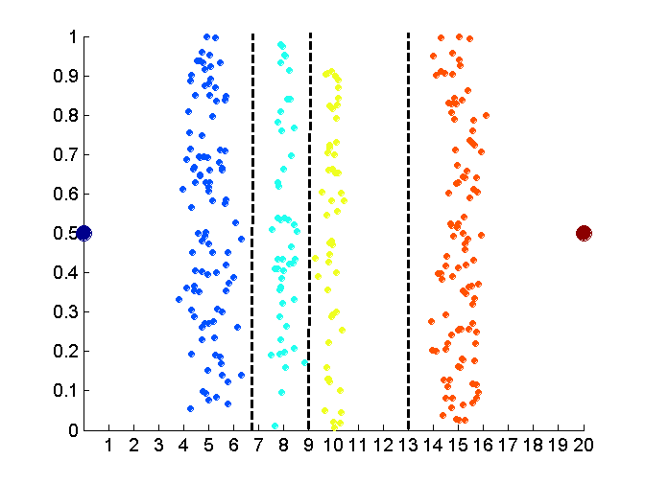
Unsupervised Discretization
Equal interval width approach
Equal frequency approach
K-means approach

Slide 58
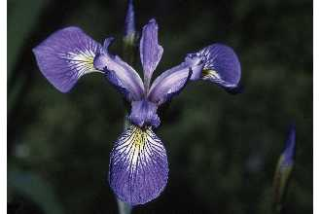
Discretization in Supervised Settings
Many classification algorithms work best if both the independent and dependent variables have only a few values
Example: Iris Plant data set.
http://www.ics.uci.edu/~mlearn/MLRepository.html
Three flower types (classes):
Setosa
Versicolour
Virginica
Four (non-class) attributes
Sepal width and length
Petal width and length

Slide 59
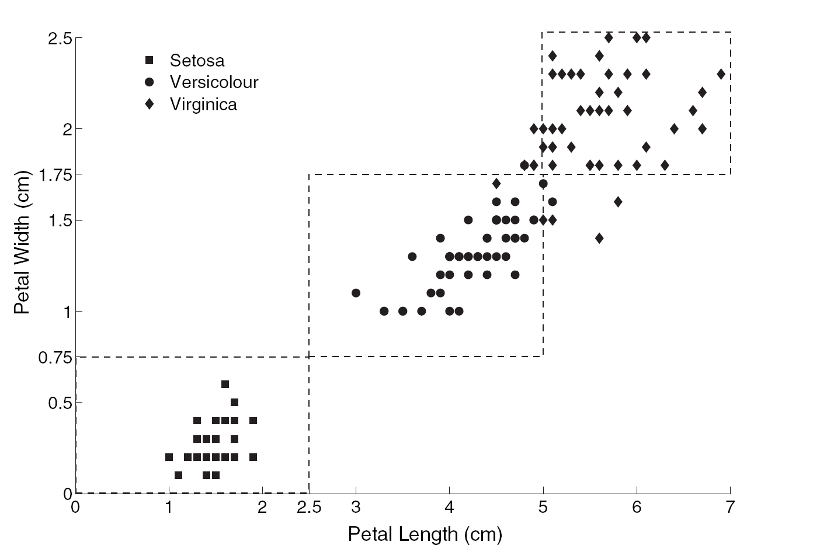
Supervised Discretization Example …
How can we tell what the best discretization is?
Supervised discretization: Use class labels to find breaks
Petal width low or petal length low implies Setosa.
Petal width medium or petal length medium implies Versicolour.
Petal width high or petal length high implies Virginica.

Slide 60
Binarization
Maps a continuous or categorical attribute into one or more binary variables
Often convert a continuous attribute to a categorical attribute and then convert a categorical attribute to a set of binary attributes
Examples: eye color and height measured as {low, medium, high}

Slide 61
Attribute Transformation
Maps the entire set of values of a given attribute to a new set of replacement values
Each original value can be identified with one of the new values
Simple functions: x^{k}, log(x), e^{x}, |x|
Normalization
Refers to various techniques to adjust to differences among attributes in terms of frequency of occurrence, mean, variance, range
Take out unwanted, common signal, e.g., seasonality
In statistics, standardization refers to subtracting off the means and dividing by the standard deviation

Slide 62
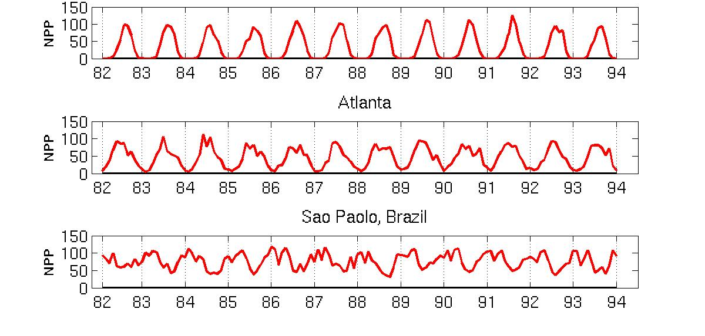
Example: Sample Time Series of Plant Growth
Minneapolis
Net Primary Production (NPP) is a measure of plant growth used by ecosystem scientists.
Correlations between time series
Correlations between time series

Slide 63
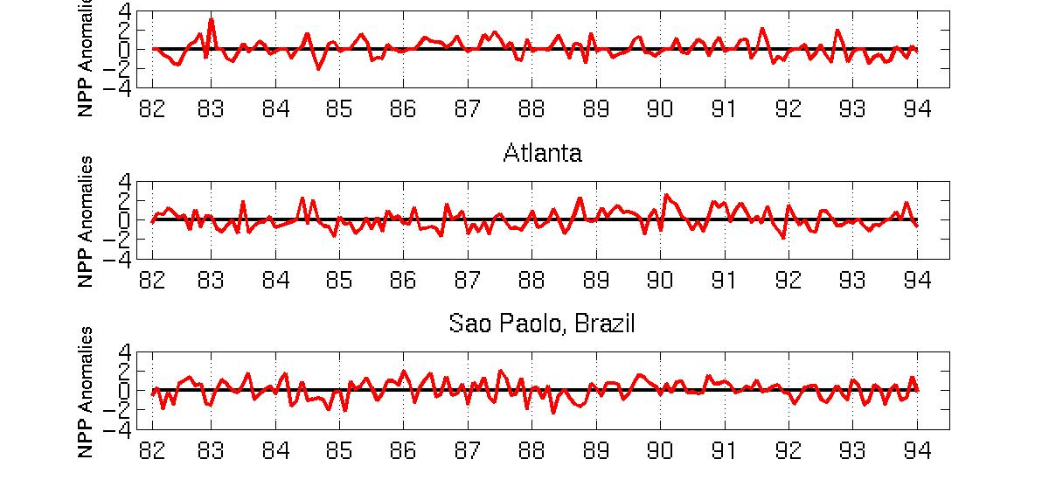
Seasonality Accounts for Much Correlation
Minneapolis
Normalized using monthly Z Score:
Subtract off monthly mean and divide by monthly standard deviation
Correlations between time series
Correlations between time series

Slide 64
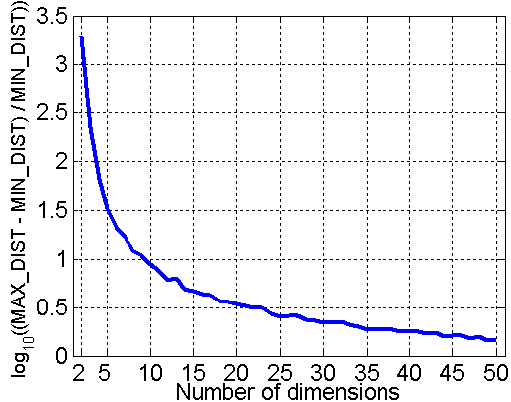
Curse of Dimensionality
When dimensionality increases, data becomes increasingly sparse in the space that it occupies
Definitions of density and distance between points, which are critical for clustering and outlier detection, become less meaningful
Randomly generate 500 points
Compute difference between max and min distance between any pair of points

Slide 65
Dimensionality Reduction
Purpose
Avoid curse of dimensionality
Reduce amount of time and memory required by ML algorithms
Allow data to be more easily visualized
May help to eliminate irrelevant features or reduce noise
Popular Techniques
Principal Components Analysis (PCA)
Singular Value Decomposition
Find a projection that captures the largest amount of variation in data
x₂
e
x₁

Slide 66
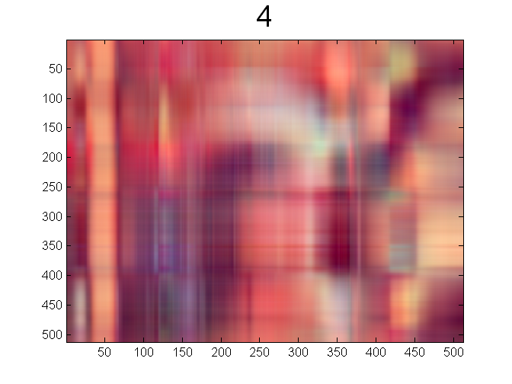
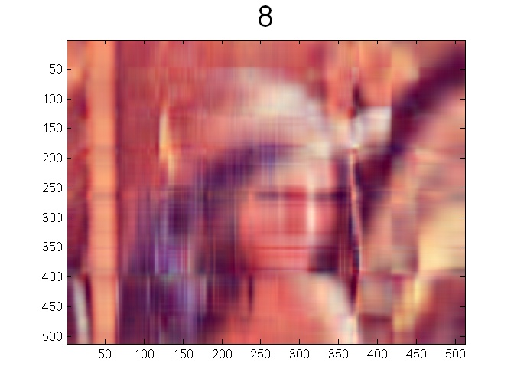


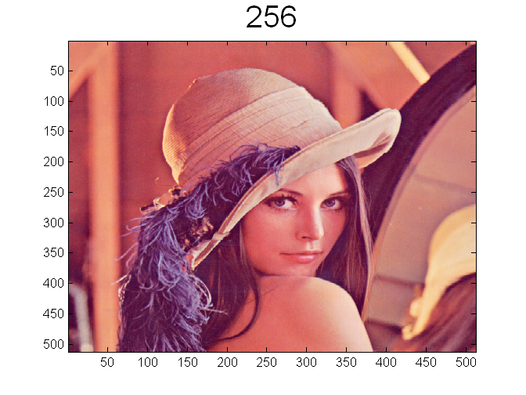
Dimensionality Reduction: PCA
Increasing # of components improve quality of reconstruction

Slide 67
Feature Subset Selection
Another way to reduce dimensionality of data
Redundant features
Duplicate much or all of the information contained in one or more other attributes
Example: purchase price of a product and the amount of sales tax paid
Irrelevant features
Contain no information that is useful for the ML task at hand
Example: students' ID is often irrelevant to the task of predicting students' GPA
Many techniques developed, especially for classification

Slide 68
Feature Creation
Create new attributes that can capture the important information in a data set
More efficiently than the original attributes
Three general methodologies
Feature extraction
Example: extracting edges from images
Feature construction
Example: dividing mass by volume to get density
Mapping data to new space
Example: Fourier and wavelet analysis

Slide 69
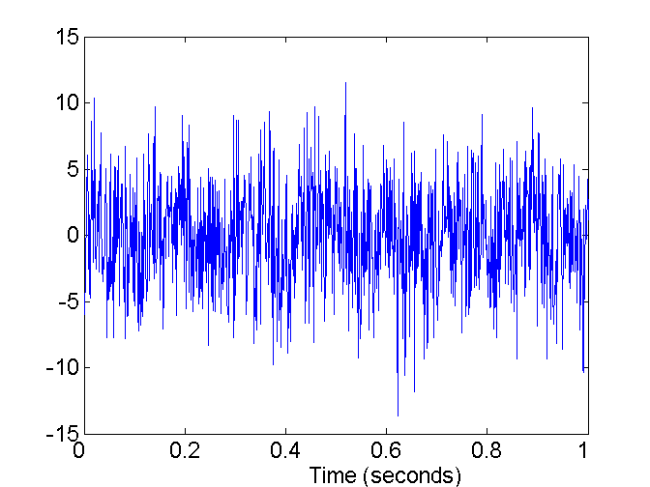
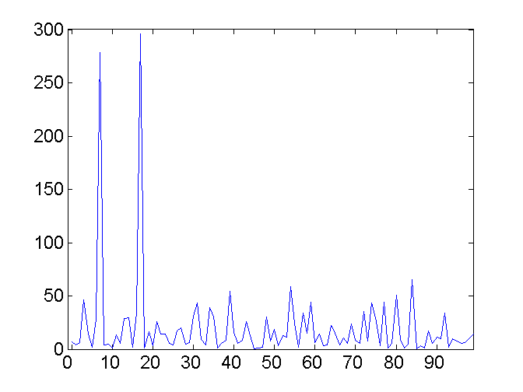
Mapping Data to a New Space
Fourier and wavelet transform - Two Sine Waves + Noise
Frequency

Slide 70
Thank You!
In our next segment: Analysis and Visualization

Slide 71
In this segment
Data Analysis
Summary Statistics
Categorical
Numerical
Distance Measures
Euclidean
Minkowski
Mahalanobis
Cosine
Correlation

Slide 72
What is data exploration?
A preliminary exploration of the data to better understand its characteristics
Key motivations of data exploration include
Helping to select the right tool for preprocessing or analysis
Making use of humans’ abilities to recognize patterns
People can recognize patterns not captured by data analysis tools
Related to the area of Exploratory Data Analysis (EDA)
The focus was on visualization
Clustering and anomaly detection were viewed as exploratory techniques
In machine learning, clustering and anomaly detection are major areas of interest, and not thought of as just exploratory

Slide 73
Summary Statistics of Data
Numbers that summarize properties of the data
Summarized properties include frequency, location and spread
Examples: location – mean, spread - standard deviation
Most summary statistics can be calculated in a single pass through the data

Slide 74
Frequency and Mode
Typically used with categorical data
Frequency of an attribute value is the percentage of time the value occurs in the data set
The mode of an attribute is the most frequent attribute value
The notions of frequency and mode are typically used with categorical data

Slide 75
Percentiles
Typically used for continuous data
Percentile is more useful.
Given an ordinal or continuous attribute x and a number p between 0 and 100, the pth percentile is a value x_{p} of x such that p% of the observed values of x are less than x_{p}.
For example, the 50th percentile is the value x_{50%} such that 50% of all values of x are less than x_{50%.} .

Slide 76
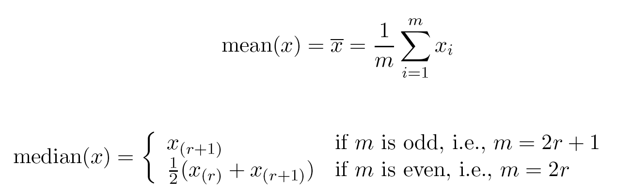
Measures of Location: Mean and Median
The mean is the most common measure of the location of a set of points.
However, the mean is very sensitive to outliers.
Thus, the median or a trimmed mean is also commonly used.
Assuming sorted {x_{i}}

Slide 77
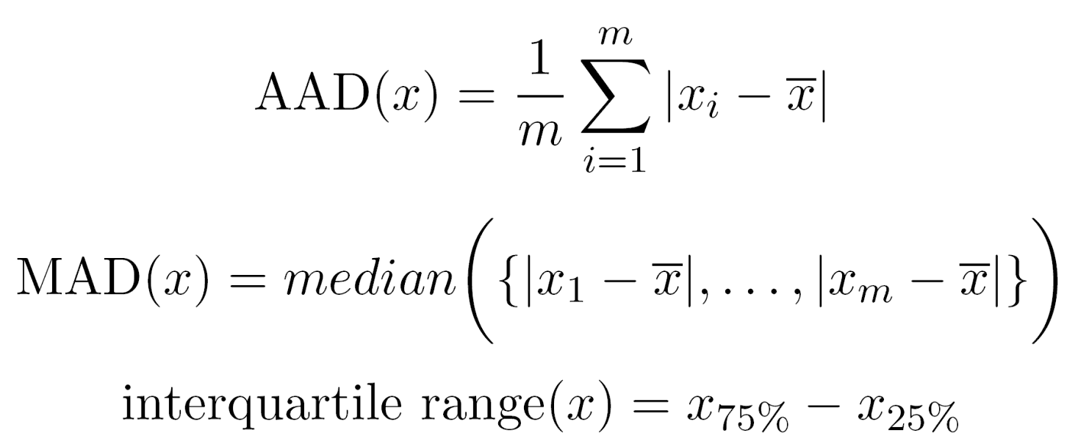
Measures of Spread: Range and Variance
Range is the difference between the max and min
The variance or standard deviation s_{x} is the most common measure of the spread of a set of points.
Because of outliers, other measures are often used. Average Absolute Distance is given by

Slide 78
Similarity and Dissimilarity Measures
Similarity measure
Numerical measure of how alike two data objects are.
Is higher when objects are more alike.
Often falls in the range [0,1]
Dissimilarity measure
Numerical measure of how different two data objects are
Lower when objects are more alike
Minimum dissimilarity is often 0
Upper limit varies
Proximity refers to a similarity or dissimilarity

Slide 79
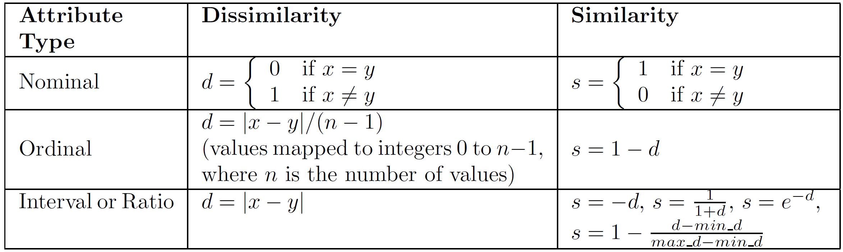
Similarity/Dissimilarity for Simple Attributes
The following table shows the similarity and dissimilarity between two objects, x and y, with respect to a single, simple attribute.

Slide 80
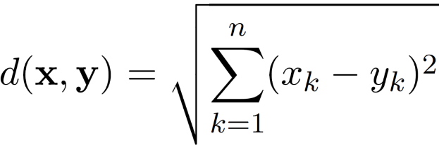
Euclidean Distance
Euclidean Distance
where n is the number of dimensions (attributes) and x_{k} and y_{k} are, respectively, the k^{th} attributes (components) or data objects x and y.
Standardization is necessary, if scales differ.

Slide 81
Euclidean Distance
Distance Matrix

Slide 82
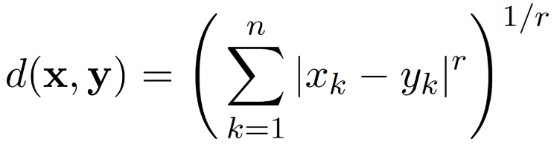
Minkowski Distance
Minkowski Distance is a generalization of Euclidean Distance
where r is a parameter, n is the number of dimensions (attributes) and x_{k} and y_{k} are, respectively, the k^{th} attributes (components) or data objects x and y.

Slide 83
Minkowski Distance: Examples
r = 1. City block (Manhattan, taxicab, L₁ norm) distance.
A common example of this for binary vectors is the Hamming distance, which is just the number of bits that are different between two binary vectors
r = 2. Euclidean distance
r → ∞. “supremum” (L_{max} norm, L∞ norm) distance.
This is the maximum difference between any component of the vectors
Do not confuse r with n, i.e., all these distances are defined for all numbers of dimensions.

Slide 84
Minkowski Distance
Distance Matrix

Slide 85
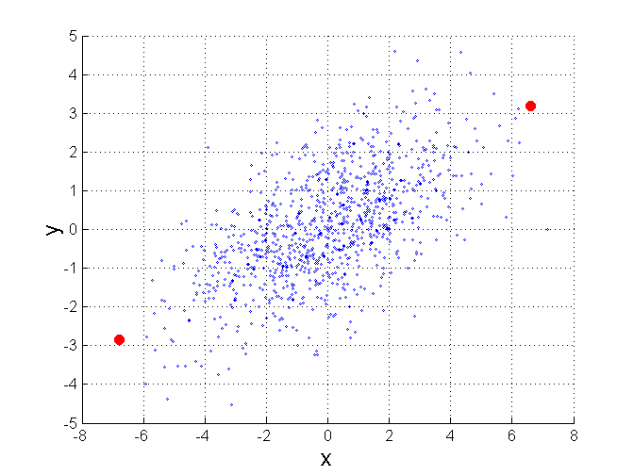
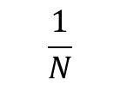
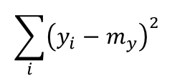
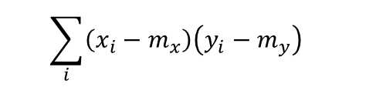
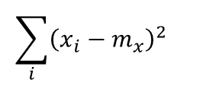
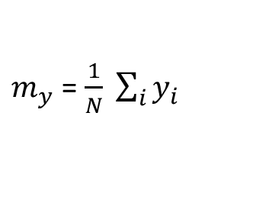
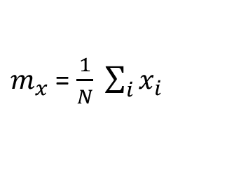
Mahalanobis Distance
$mahalanobis\left(x,y\right)={ ((x−y)}^{T}Ʃ^{−1}(x−y))$^{-0.5}
Σ is the covariance matrix
$$\sum_{i}{{\left(x_{i}−m_{x}\right)}^{2} }$$
$$\sum_{i}{{\left(x_{i}−m_{x}\right)\left(y_{i}−m_{y}\right)}^{ } }$$
$$\frac{1}{N}$$
$$\sum_{i}{{\left(x_{i}−m_{x}\right)\left(y_{i}−m_{y}\right)}^{ } }$$
$$\sum_{i}{{\left(y_{i}−m_{y}\right)}^{2} }$$
$m_{x}$ = $\frac{1}{N} \sum_{i}{x_{i}}$
$m_{y}$ = $\frac{1}{N} \sum_{i}{y_{i}}$
For red points, the Euclidean distance is 14.7, Mahalanobis distance is 6.

Slide 86
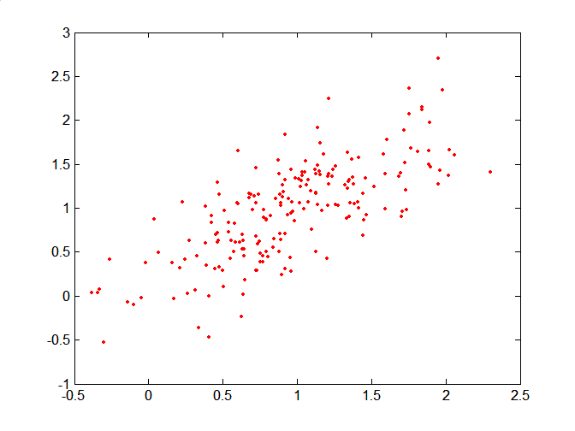
Mahalanobis Distance
Covariance Matrix:
C
A: (0.5, 0.5)
B: (0, 1)
C: (1.5, 1.5)
Mahal(A,B) = 5
Mahal(A,C) = 4
B
A

Slide 87
Common Properties of a Distance
Distances, such as the Euclidean distance, have some well known properties.
d(x, y) ≥ 0 for all x and y and d(x, y) = 0 if and only if x = y.
d(x, y) = d(y, x) for all x and y. (Symmetry)
d(x, z) ≤ d(x, y) + d(y, z) for all points x, y, and z. (Triangle Inequality)
where d(x, y) is the distance (dissimilarity) between points (data objects), x and y.
A distance that satisfies these properties is a metric

Slide 88
Similarity Between Binary Vectors
Common situation is that objects, x and y, have only binary attributes
Compute similarities using the following quantities
f₀₁ = the number of attributes where x was 0 and y was 1
f₁₀ = the number of attributes where x was 1 and y was 0
f₀₀ = the number of attributes where x was 0 and y was 0
f₁₁ = the number of attributes where x was 1 and y was 1
Simple Matching and Jaccard Coefficients
SMC = number of matches / number of attributes
= (f₁₁ + f₀₀) / (f₀₁ + f₁₀ + f₁₁ + f₀₀)
J = number of 11 matches / number of non-zero attributes
= (f₁₁) / (f₀₁ + f₁₀ + f₁₁)

Slide 89
SMC versus Jaccard: Example
x = 1 0 0 0 0 0 0 0 0 0
y = 0 0 0 0 0 0 1 0 0 1
f₀₁ = 2 (the number of attributes where x was 0 and y was 1)
f₁₀ = 1 (the number of attributes where x was 1 and y was 0)
f₀₀ = 7 (the number of attributes where x was 0 and y was 0)
f₁₁ = 0 (the number of attributes where x was 1 and y was 1)
SMC = (f₁₁ + f₀₀) / (f₀₁ + f₁₀ + f₁₁ + f₀₀)
= (0+7) / (2+1+0+7) = 0.7
J = (f₁₁) / (f₀₁ + f₁₀ + f₁₁) = 0 / (2 + 1 + 0) = 0

Slide 90
Cosine Similarity
If d₁ and d₂ are two document vectors, then
cos( d₁, d₂ ) = <d₁,d₂> / ||d₁|| ||d₂|| ,
where <d₁,d₂> indicates inner product or vector dot product of vectors, d₁ and d_{2,} and || d || is the length of vector d.
Example:
d₁ = 3 2 0 5 0 0 0 2 0 0
d₂ = 1 0 0 0 0 0 0 1 0 2
<d₁, d2> = 3*1 + 2*0 + 0*0 + 5*0 + 0*0 + 0*0 + 0*0 + 2*1 + 0*0 + 0*2 = 5
| d₁ || = (3*3+2*2+0*0+5*5+0*0+0*0+0*0+2*2+0*0+0*0)^{0.5} = (42) ^{0.5} = 6.481
|| d₂ || = (1*1+0*0+0*0+0*0+0*0+0*0+0*0+1*1+0*0+2*2) ^{0.5} = (6) ^{0.5} = 2.449
cos(d₁, d₂ ) = 0.3150

Slide 91
Common Properties of a Similarity
Similarities, also have some well known properties.
s(x, y) = 1 (or maximum similarity) only if x = y. (does not always hold, e.g., cosine)
s(x, y) = s(y, x) for all x and y. (Symmetry)
where s(x, y) is the similarity between points (data objects), x and y.

Slide 92
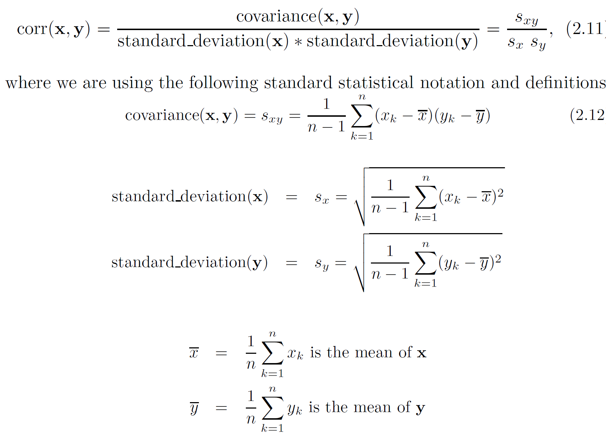
Correlation measures the linear relationship between objects

Slide 93
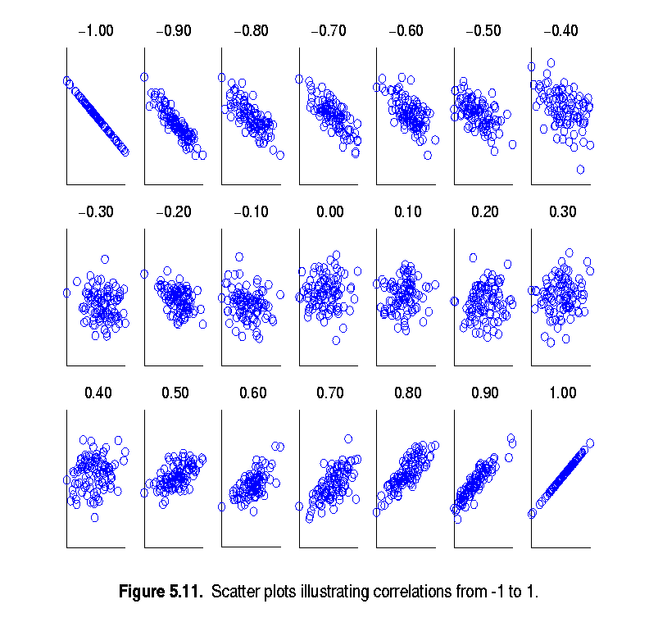
Visually Evaluating Correlation
Scatter plots showing the similarity from –1 to 1.

Slide 94
Drawback of Correlation
x = (-3, -2, -1, 0, 1, 2, 3)
y = (9, 4, 1, 0, 1, 4, 9)
y_{i} = x_{i}²
mean(x) = 0, mean(y) = 4
std(x) = 2.16, std(y) = 3.74
corr = (-3)(5)+(-2)(0)+(-1)(-3)+(0)(-4)+(1)(-3)+(2)(0)+3(5) / ( 6 * 2.16 * 3.74 )
= 0

Slide 95
Correlation vs Cosine vs Euclidean Distance
Compare the three proximity measures according to their behavior under variable transformation
scaling: multiplication by a value
translation: adding a constant
Consider the example
x = (1, 2, 4, 3, 0, 0, 0), y = (1, 2, 3, 4, 0, 0, 0)
y_{s} = y * 2 (scaled version of y), y_{t} = y + 5 (translated version)
Property | Cosine | Correlation | Euclidean Distance
Invariant to scaling (multiplication) | Yes | Yes | No
Invariant to translation (addition) | No | Yes | No
Measure | (x , y) | (x , y_{s}) | (x , y_{t})
Cosine | 0.9667 | 0.9667 | 0.7940
Correlation | 0.9429 | 0.9429 | 0.9429
Euclidean Distance | 1.4142 | 5.8310 | 14.2127

Slide 96
Correlation vs cosine vs Euclidean distance
Choice of the right proximity measure depends on the domain
What is the correct choice of proximity measure for the following situations?
Comparing documents using the frequencies of words
Documents are considered similar if the word frequencies are similar
Comparing the temperature in Celsius of two locations
Two locations are considered similar if the temperatures are similar in magnitude
Comparing two time series of temperature measured in Celsius
Two time series are considered similar if their “shape” is similar, i.e., they vary in the same way over time, achieving minimums and maximums at similar times, etc.

Slide 97
Comparison of Proximity Measures
Domain of application
Similarity measures tend to be specific to the type of attribute and data
Record data, images, graphs, sequences, 3D-protein structure, etc. tend to have different measures
However, one can talk about various properties that you would like a proximity measure to have
Symmetry is a common one
Tolerance to noise and outliers is another
Ability to find more types of patterns?
Many others possible
The measure must be applicable to the data and produce results that agree with domain knowledge

Slide 98
Thank You!
In our next segment: Visualization

Slide 99
In this segment
Data Visualization
Visualization Plots
Histogram
Boxplot
Contour
Scatter Plot
Matrix Plots
Correlation Plots

Slide 100
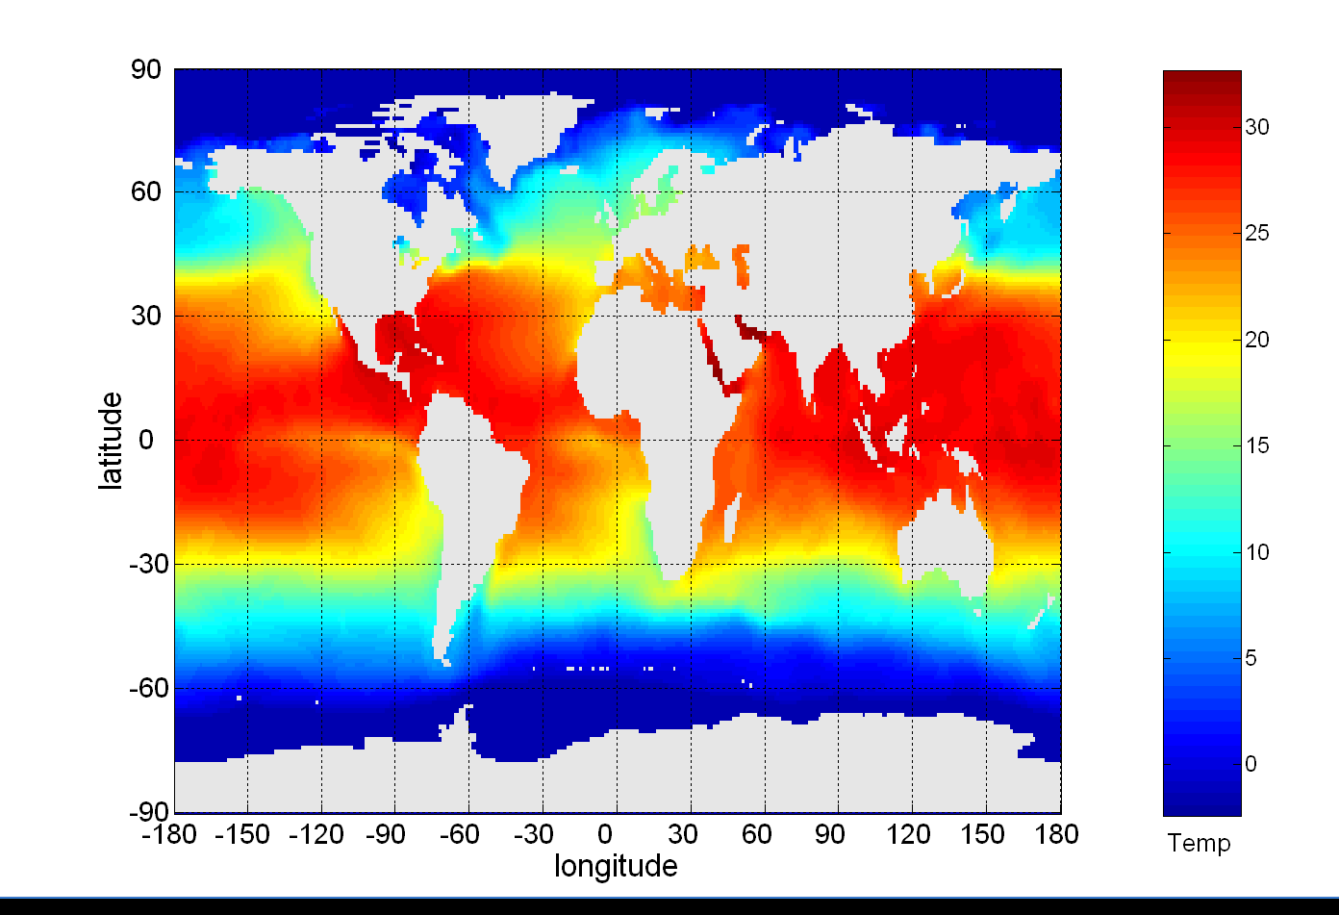
Visualization
Conversion of data into a visual or tabular format
Visualization of data is one of the most powerful and appealing techniques for data exploration.
Humans have a well developed ability to analyze large amounts of information that is presented visually
Can detect general patterns and trends
Can detect outliers and unusual patterns
Data objects, their attributes, and the relationships among data objects are translated into graphical elements such as points, lines, shapes, and colors.
Example:
Objects are often represented as points
Their attribute values can be represented as the position of the points or the characteristics of the points, e.g., color, size, and shape
Sea Surface Temperature (SST) for July 1982

Slide 101
Representation
Mapping information to a visual format
Data objects, their attributes, and the relationships among data objects are translated into graphical elements such as points, lines, shapes, and colors.
Example:
Objects are often represented as points
Their attribute values can be represented as the position of the points or the characteristics of the points, e.g., color, size, and shape
If position is used, then the relationships of points, i.e., whether they form groups or a point is an outlier, is easily perceived.

Slide 102
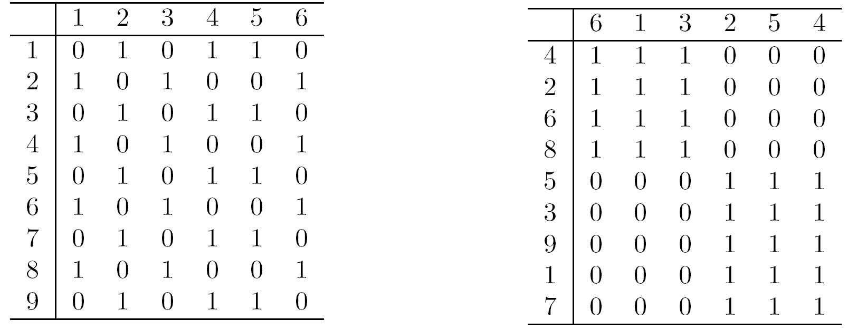
Arrangement
Placement of visual elements within a display
Is the Can make a large difference in how easy it is to understand the data
Example:

Slide 103
Selection
Elimination or the de-emphasis of certain objects and attributes
Selection may involve the choosing a subset of attributes
Dimensionality reduction is often used to reduce the number of dimensions to two or three
Alternatively, pairs of attributes can be considered
Selection may also involve choosing a subset of objects
A region of the screen can only show so many points
Can sample, but want to preserve points in sparse areas

Slide 104
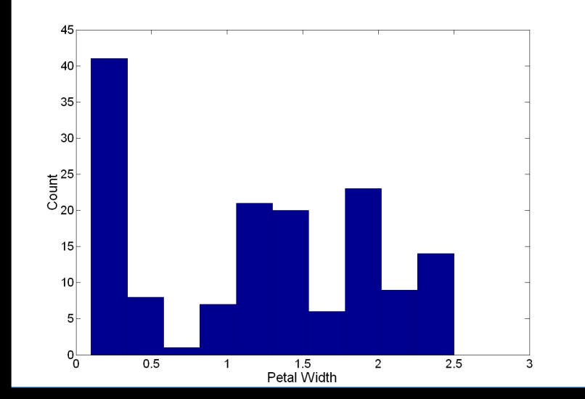
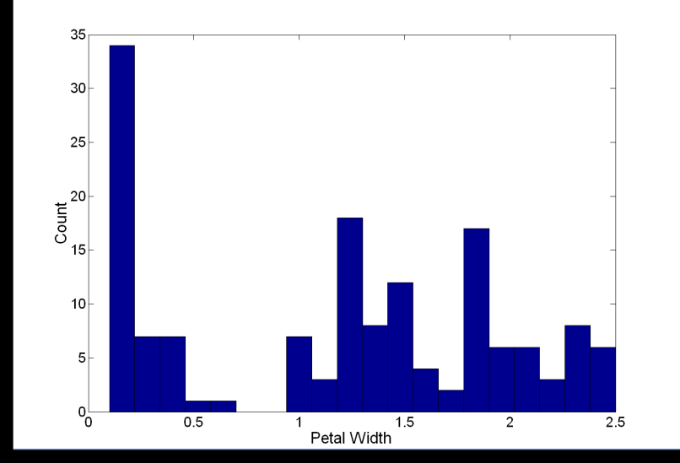
Visualization Techniques: Histograms
Histogram
Usually shows the distribution of values of a single variable
Divide the values into bins and show a bar plot of the number of objects in each bin.
The height of each bar indicates the number of objects
Shape of histogram depends on the number of bins
Example: Petal Width (10 and 20 bins, respectively)

Slide 105
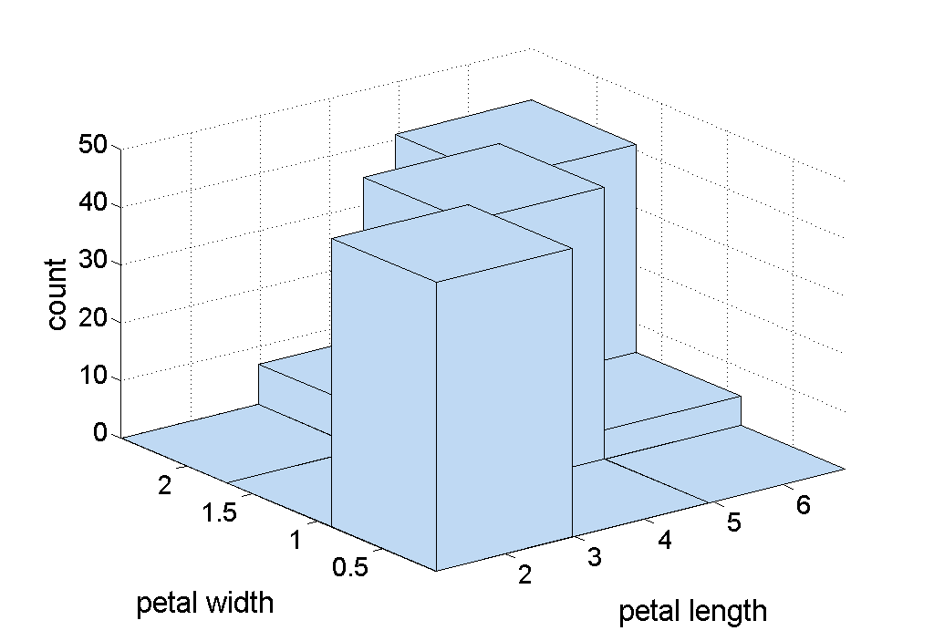
Two-Dimensional Histograms
Show the joint distribution of the values of two attributes
Example: petal width and petal length

Slide 106
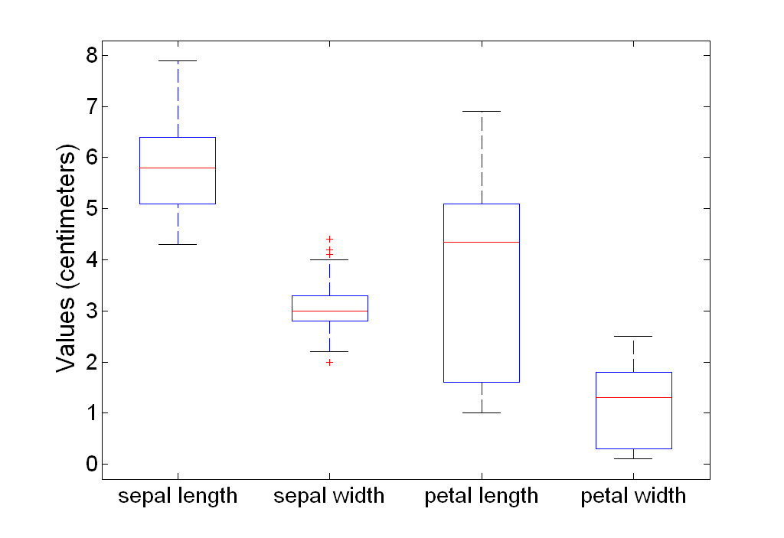
Visualization Techniques: Box Plots
Display distribution of data
outlier
90th percentile
75th percentile
50th percentile
25th percentile
10th percentile

Slide 107

Visualization Techniques: Scatter Plots
Attributes values determine the position
Scatter plots can compactly summarize the relationships of several pairs of attributes
Example: Iris Plant dataset http://www.ics.uci.edu/~mlearn/MLRepository.html
Three flower types (classes): Setosa, Versicolour, Virginica
Four (non-class) attributes: Sepal width and length, Petal width and length

Slide 108

Visualization Techniques: Contour Plots
Continuous attribute is measured on a spatial grid
Useful when a They partition the plane into regions of similar values
The contour lines that form the boundaries of these regions connect points with equal values
Common example: contour maps of elevation, temperature, rainfall, air pressure, etc.
Celsius
Surface Sea Temperature

Slide 109

Visualization Techniques: Matrix Plots
Plot data matrix
Often useful when objects are sorted according to class
Plots of similarity or distance matrices can also be useful for visualizing the relationships
standard
deviation

Slide 110
Visualization of the Iris Data Matrix
standard
deviation

Slide 111

Visualization of the Iris Correlation Matrix

Slide 112
Thank You!
In our next segment: Software Infrastructure

Slide 113
In this segment
Software Tools for ML
Notebooks and Colab
Python and important libraries
A few important functions
Missing data
Attribute Visualization
Data Cleaning
Attribute Combination
Handling categorical attributes
Test dataset Creation

Slide 114
Prerequisites
Jupyter Notebook
Open-source web application to create and share live code, equations, visualizations and narrative text.
Used for data cleaning and transformation, numerical simulation, statistical modeling, data visualization, machine learning, and much more.
Easy to tinker with code and execute it in steps
Run in local browser: https://jupyter.org/try
Local installation: https://jupyter.org/install.html
Repository of Jupyter Notebooks: https://github.com/ageron/handson-ml
Colab
Google’s flavor of Jupyter notebooks tailored for machine learning and data analysis
Runs entirely in the cloud.
free access to hardware accelerators like GPUs and TPUs (with some restrictions).
http://colab.research.google.com
Popular Datasets
UC Irvine Machine Learning Repository: http://archive.ics.uci.edu/ml/
Kaggle datasets: https://www.kaggle.com/datasets
Amazon’s AWS datasets: http://aws.amazon.com/fr/datasets/

Slide 115

Local Installation
Preferred Mode
Install a virtual environment via Anaconda
Free Anaconda Python distribution: https://www.anaconda.com/products/individual
Download Python 3.* version

Slide 116
Prerequisites
Python and several scientific libraries
Python
high-level, dynamically typed multiparadigm programming language.
almost like pseudocode, very readable
Platform: Linux/Windows/MacOS
Documentation: https://www.python.org/doc/
Interactive Python tutorial: http://learnpython.org/
Stand alone installation: (preferably 3.7 or higher) https://www.python.org/downloads/
scikit-learn
Open source library that supports supervised and unsupervised learning.
Various model fitting, data preprocessing, model selection and evaluation tools, and other utilities.
Platform: Linux/Windows/MacOS
User guide: https://scikit-learn.org/stable/user_guide.html
Stand alone installation: https://scikit-learn.org/stable/install.html

Slide 117
Prerequisites
Important libraries
Numpy
Scientific computing library with Python
Provides high-performance multidimensional array (e.g., vector, matrix) and basic tools to compute with and manipulate these arrays, linear algebra, random number generators
https://numpy.org/doc/stable/reference/
https://numpy.org/install/
SciPy
Builds on numpy, provides functions that operate on numpy arrays
Useful for different types of scientific and engineering applications, integration, image processing, …
https://docs.scipy.org/doc/scipy/reference/tutorial/index.html
Standalone installation: https://scipy.org/install.html
Matplotlib
Plotting library
https://matplotlib.org/
https://matplotlib.org/tutorials/index.html
https://matplotlib.org/users/installing.html

Slide 118



Important ML Steps and Functions
https://github.com/ageron/handson-ml/blob/master/02_end_to_end_machine_learning_project.ipynb
20,640 data instances in the dataset – fairly small
207 districts are missing total_bedrooms attribute
except ocean_proximity, rest of the attributes numerical
type of ocean_proximity is object, so it must be a text attribute - a repeated categorical attribute!

Slide 119
Important ML Steps and Functions
20,640 data instances in the dataset – fairly small
207 districts are missing total_bedrooms attribute
except ocean_proximity, rest of the attributes numerical
type of ocean_proximity is object, so it must be a text attribute - a repeated categorical attribute!

Slide 120



Attribute Visualization
age
latitude
# of households
longitude
price
income

Slide 121
Observations from Histogram
Median income attribute not expressed in US dollars (USD).
scaled and capped at 15 for higher median incomes, and at 0.5 for lower median incomes.
The housing median age and the median house value also capped.
Machine Learning algorithms may learn that prices never go beyond that limit.
If precise predictions even beyond $500,000 is needed
Collect proper labels for the districts whose labels were capped.
Remove those districts from the training set and also from the test set
Attributes have very different scales.
Finally, many histograms are tail heavy.
Transformation may be needed on to have more bell-shaped distributions

Slide 122


Visualizing Training Data for Insights

Slide 123


Correlations in Training Data
House prices are strongly correlated with income
small negative correlation between the latitude and the median house value
i.e., prices have a slight tendency to go down when you go north)
price cap clearly visible as a horizontal line at $500K.
Additional horizontal lines around $450k, $350K, perhaps one around $280K, ...

Slide 124


Experimenting with Attribute Combinations
Total number of rooms in a district not very useful
What may be important is the number of rooms per household.
Similarly, the total number of bedrooms compared to the number of rooms may be more meaningful
rooms_per_household is more correlated with price than total number of bedrooms or rooms.

Slide 125


Data Cleaning
Some of the instances don’t have total_bedroom values
Imputer utility in scikit-learn
Since median applies only to numerical data, create an copy of the data without ocean-proximity
The imputer stores the median of each attribute the result in its statistics_ instance variable.
Use this “trained” imputer to replace any missing values by the learned medians

Slide 126



Handling Textual and Categorical Data
Convert the text attributes to numbers
Scikit-learn provides a transformer
ML algorithms assume closer values are more similar. But ‘<1H OCEAN’ and ‘NEAR OCEAN’ are far away in values!
Solution! Use 1-hot encoding

Slide 127



Test Set Creation
Ensures reproducibility of results
Test set size is 20% of training set
Uses uniform sampling of data.
Not appropriate for heavy tailed distribution
income very important to predict house prices.
Important that test set is representative of the various categories of incomes in the dataset.
Most income values are around $20–$50K, but some >> $60K.
Histogram of income categories

Slide 128
Thank You!
In our next session: Model Building

